Slide 1
ASP.NET Core Deep Dive
Gan Leng Keong
28 August 2026

Slide 2
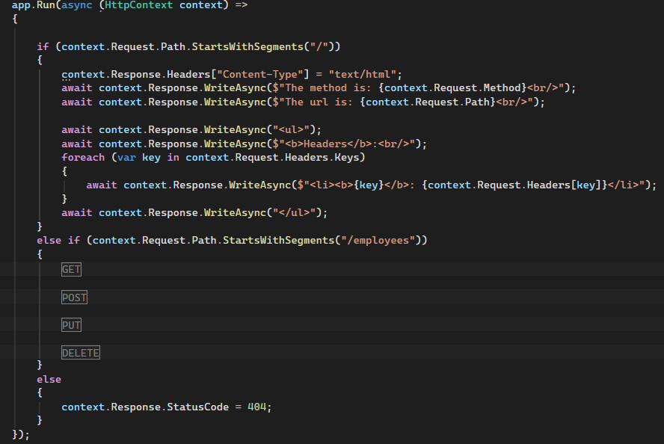
App.Run

Slide 3
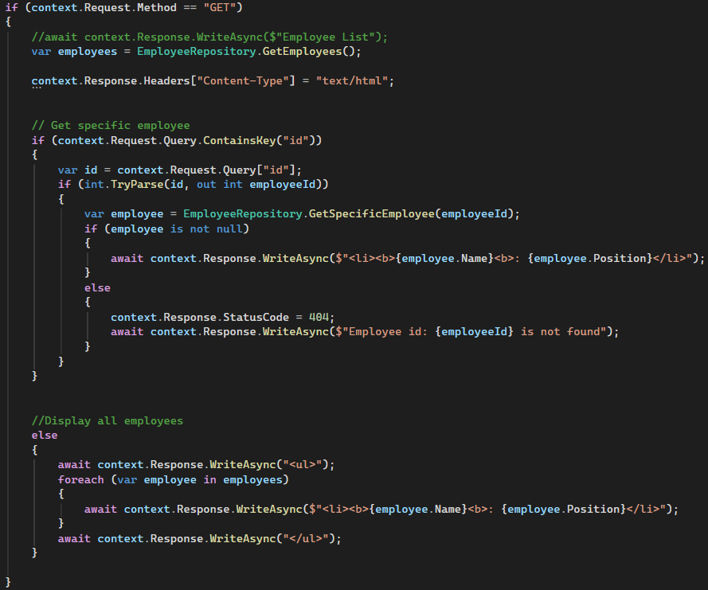
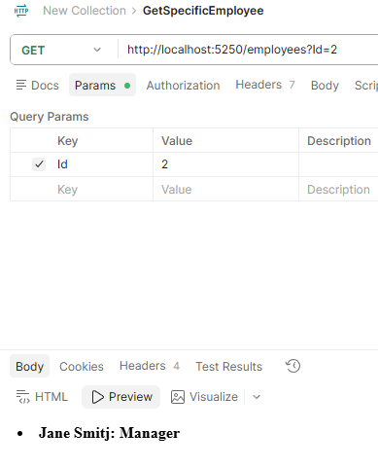
HTTP GET – All employees data and display
Query string begin with ? sign

Slide 4
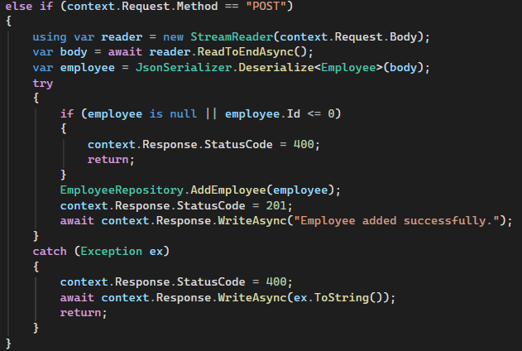
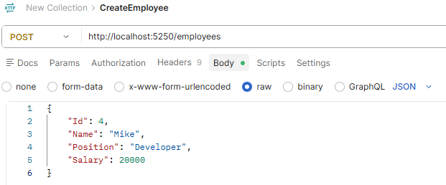
HTTP POST – Create an Employee data
Submit the data in JSON format

Slide 5
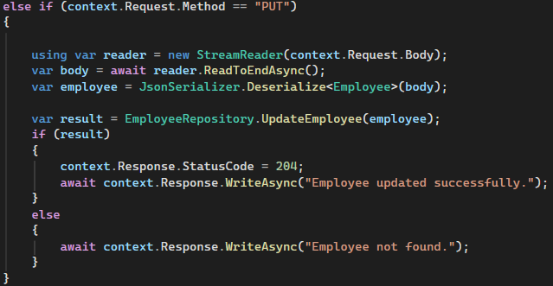
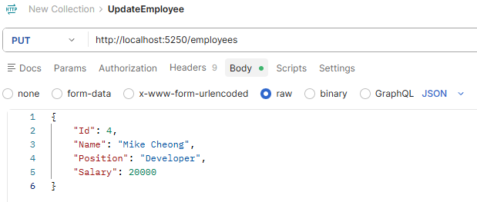
HTTP PUT – Update an Employee data
Submit the data in JSON format

Slide 6
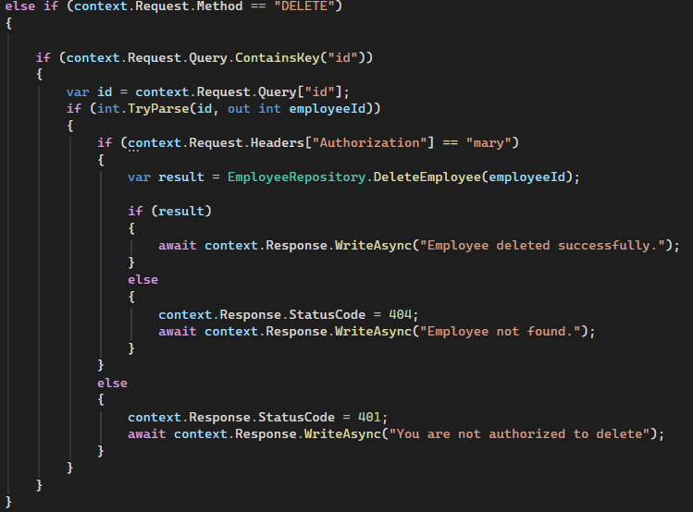
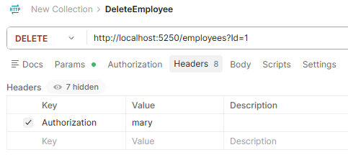
HTTP DELETE – Delete an Employee data
Only Authorized person can delete

Slide 7
Middleware concepts
Call direction
Middleware#1
Middleware#2
Middleware#3
Middleware #n
Return direction
Middleware will call until last middleware (terminal) and return the value

Slide 8
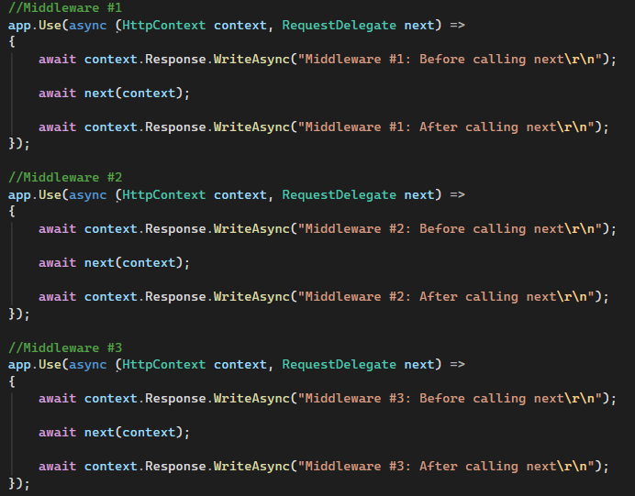
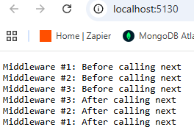
Sample Middleware code
Await next(context) call to next middleware

Slide 9
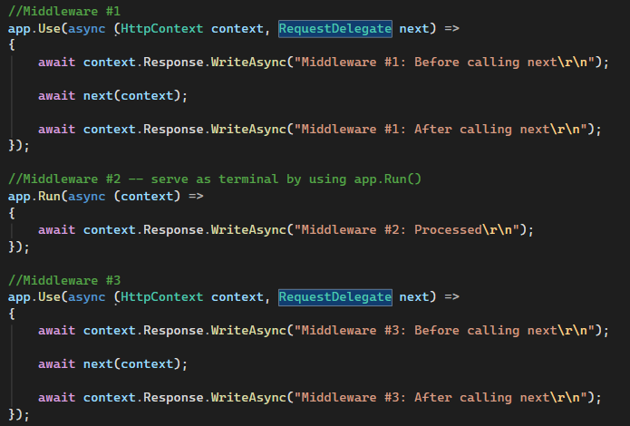
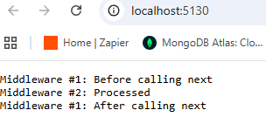
App.Run serve as terminal
Middleware #3 will not get call

Slide 10
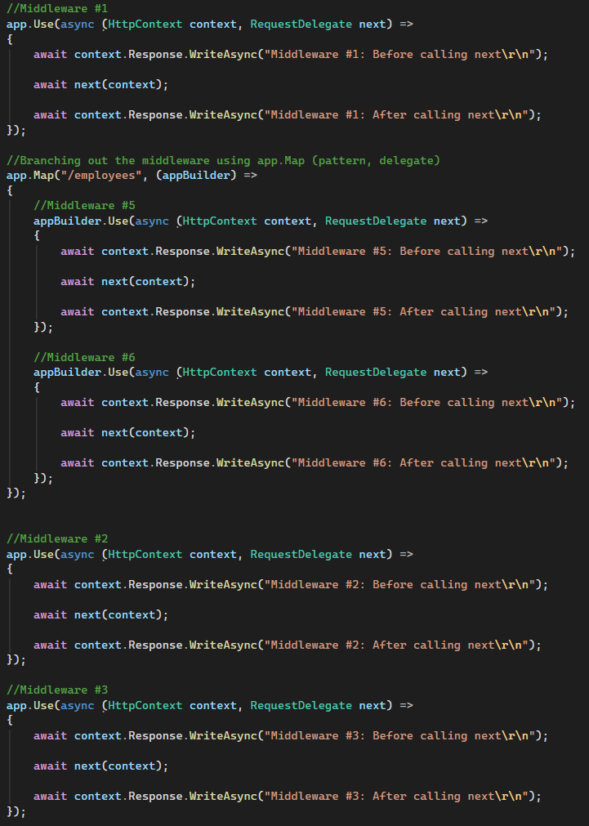
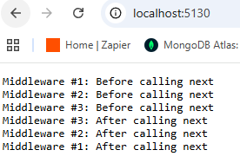
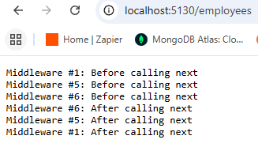
Branching out the middleware using app.Map
Middleware#2
Middleware#3
http://localhost:5130
Middleware#1
http://localhost:5130/employees
Middleware#5
Middleware#6

Slide 11
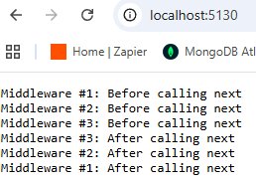
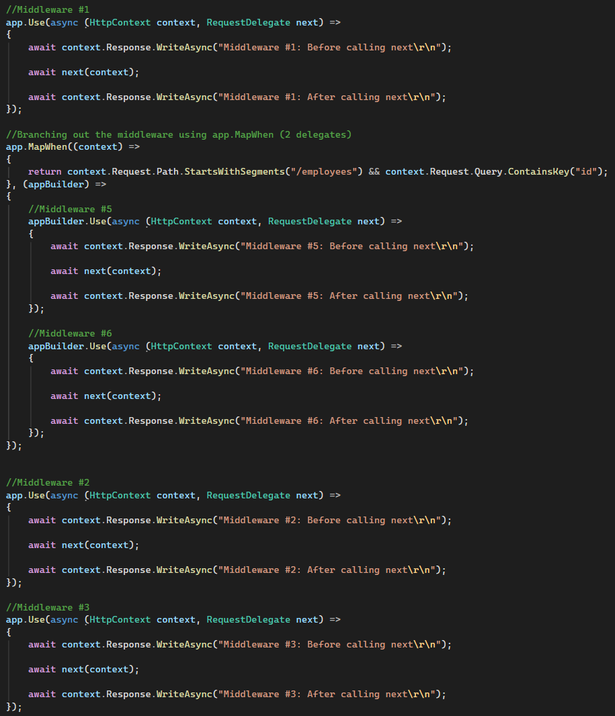
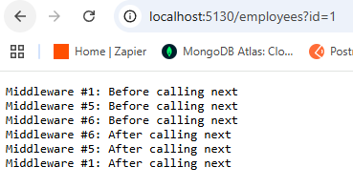
Branching out the middleware using app.MapWhen
Similar to app.Map. Just it accept more predicate pattern instead of one.
Middleware#2
Middleware#3
http://localhost:5130
Middleware#1
http://localhost:5130/employees?id=1
Middleware#5
Middleware#6

Slide 12
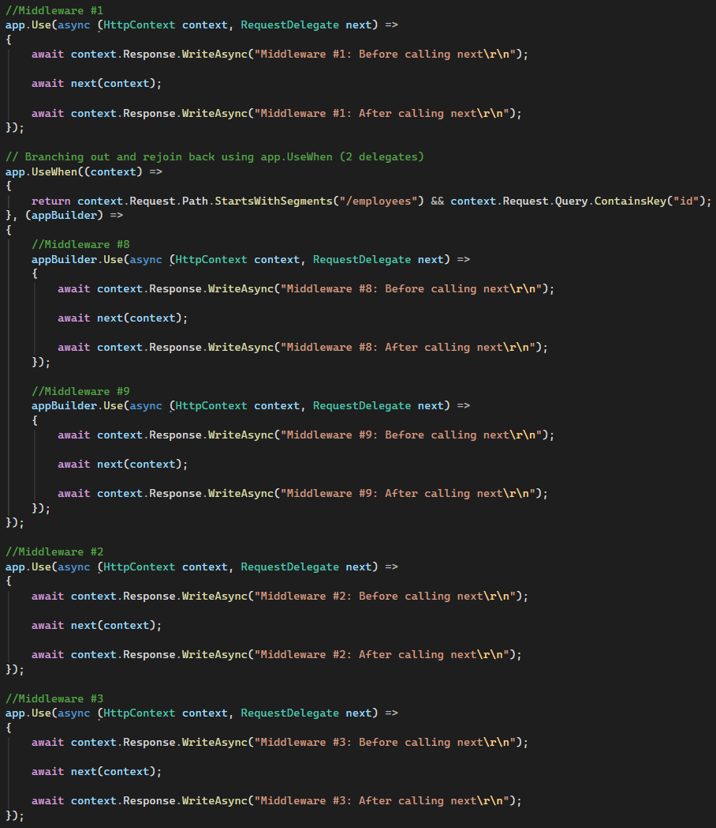
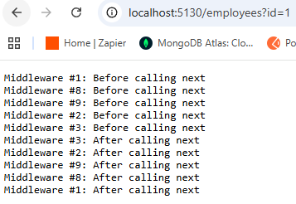
Branching out and Rejoin back using app.UseWhen
Middleware#1
Middleware#8
Middleware#9
Middleware#2
Middleware#3

Slide 13
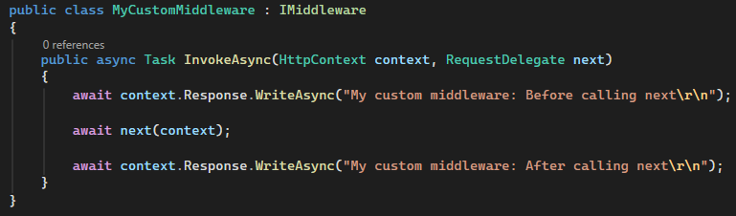

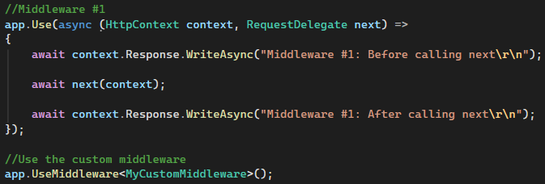
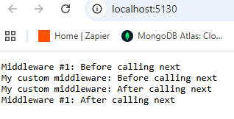
Using custom middleware
Implement the interface: IMiddleware
Register the custom middleware
Use app.UseMiddleware<Type> to use it

Slide 14
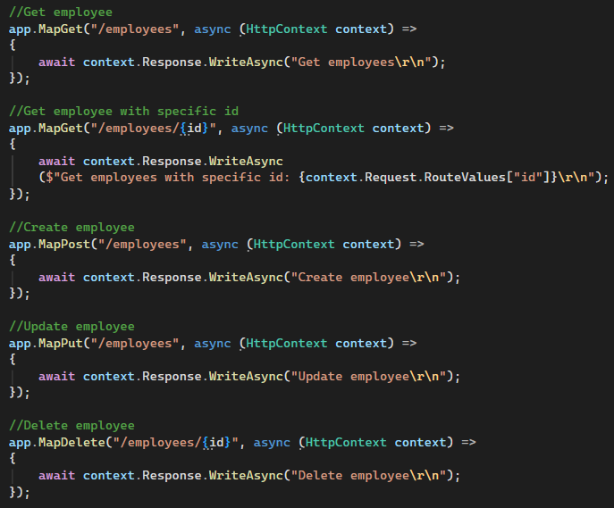
Endpoints
An endpoint handles a request and return a response

Slide 15
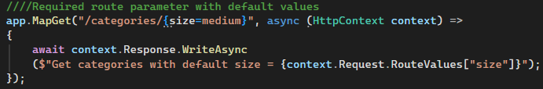
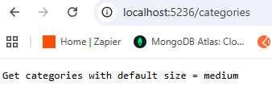
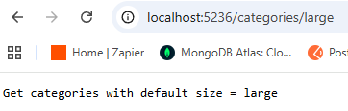
Required route parameter with default values
Auto send put “medium” as size
Overwrite by putting “large” as size

Slide 16
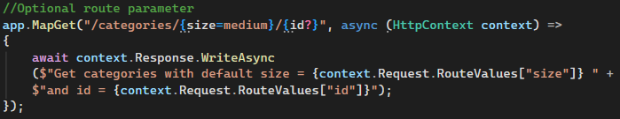
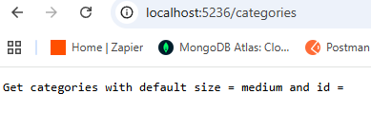
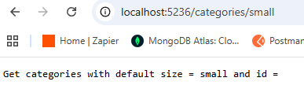
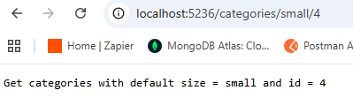
Optional route parameter

Slide 17
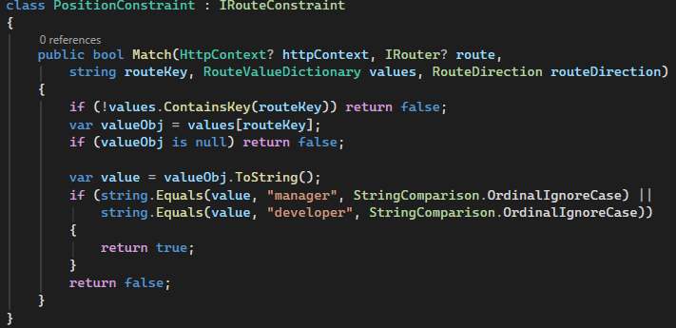
Custom parameter constraint
Implement the IRouteConstraint interface

Slide 18
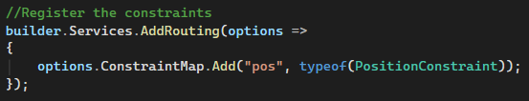
Custom parameter constraint
Register the constraint

Slide 19
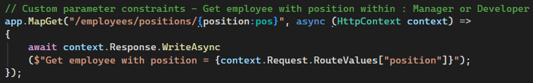
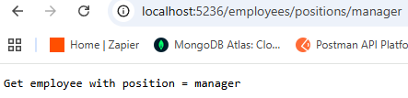
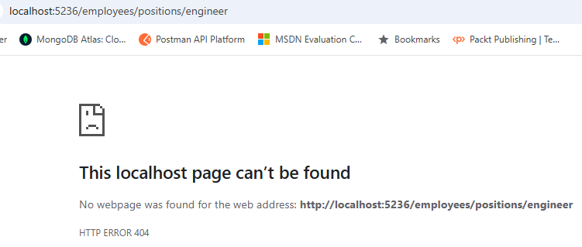
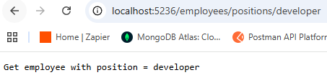
Custom parameter constraint
Use the constraint
Get error if position is not manager or developer

Slide 20
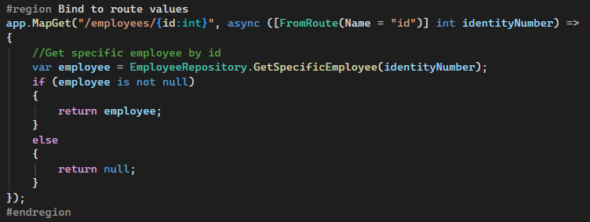
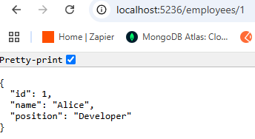
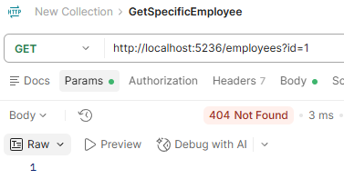
Bind to route values
Explicitly mention the id is FromRoute where the name is called “id”
It return 404 status code if using query string

Slide 21
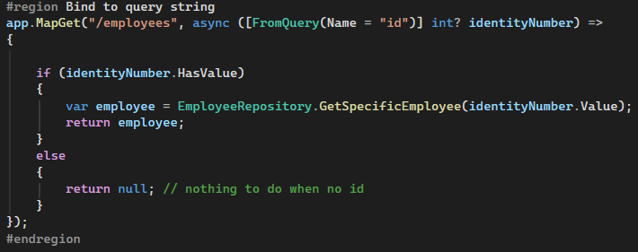
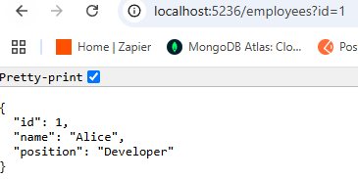
Bind to query string

Slide 22
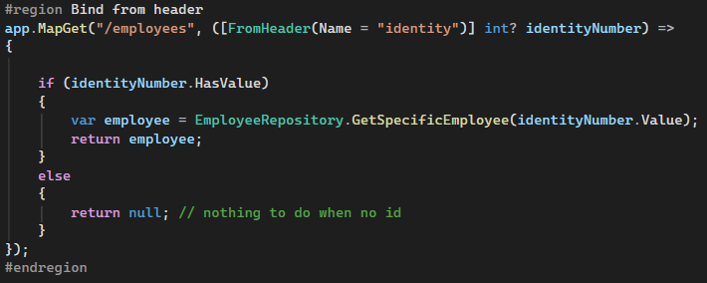
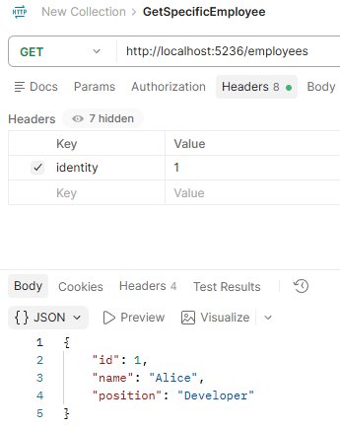
Bind from header

Slide 23
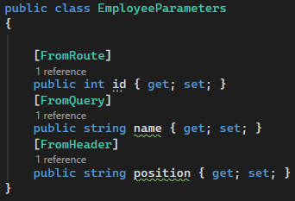
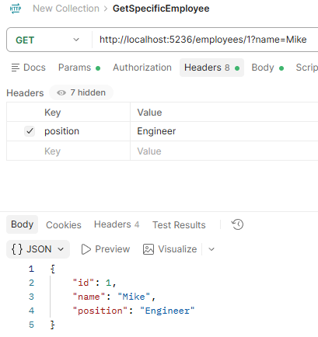
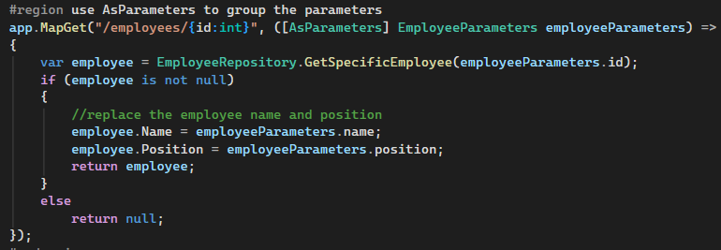
use AsParameters to group the parameters

Slide 24
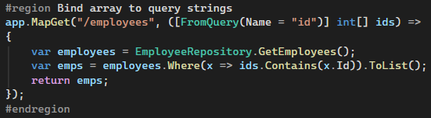
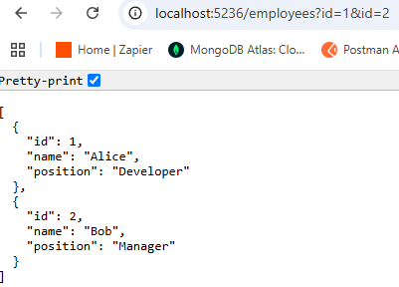
Bind array to query strings

Slide 25


Bind array to headers

Slide 26




Binding to http body

Slide 27



Custom Binding with BindAsync method

Slide 28




Validate with Data Annotation
Mention the data annotation
Register the service

Slide 29

Custom Model Validation with ValidationAttribute
Implement Validation Attribute class

Slide 30


Custom Model Validation with ValidationAttribute
Add Custom Model Validation [Employee_EnsureSalary]
Note: Register the validation service is a must

Slide 31

Custom Model Validation with IValidatableObject
Implement the IValidatableObject interface
Put the implementation logic

Slide 32

Custom Model Validation with IValidatableObject
Note: Register the validation service is a must

Slide 33

Minimal Api return type

Slide 34

Mix and Match Results and TypeResults
Both implement IResult interface

Slide 35


The problem details standard
Different types of error message were returned.

Slide 36

The problem details standard
Fix by return Results.ValidationProblem

Slide 37

The problem details standard
Return the problem details in standard way

Slide 38


Standardize the Api result
Sending null employee
Showing error in different way
Browsing to not existing URL

Slide 39



Standardize the Api result
Add those 2 lines to fix the problems

Slide 40

Customize Result by implementing IResult
Implement IResult interface and feed the html string

Slide 41


Customize Result by implementing IResult

